Slide 1
Used Car Price Estimator
Regression Project
Notes:
ID=d924773e-9a16-4d6d-9803-8cb819e99682 Recipe=text_billboard Type=TextOnly Variant=0 FamilyID=AccentBoxWalbaum_Zero

Slide 2
Used Car Price Estimator using Regression
Introduction
Buying or selling a used car involves many factors that influence its price, such as how old the car is, how far it has been driven, the type of fuel it uses, and whether it has manual or automatic transmission. Predicting a fair price can be difficult because the used car market is complex and prices vary widely depending on different conditions. In this project, we aimed to build a Linear Regression model that can help estimate the price of a used car based on its features.
To begin, we collected and explored a dataset containing several details about used cars. We performed data cleaning to remove missing or inconsistent values, and handled incorrect data types. We then applied feature engineering, such as calculating the car's age from its manufacturing year, which is an important factor in determining depreciation.
Since the price values were highly skewed—meaning some cars were much more expensive than others—we applied a logarithmic transformation to the price column. This helped the model better understand the relationship between features and the target (price) by reducing the impact of extreme values.

Slide 3
Regression Project
Preprocessing Steps

Slide 4
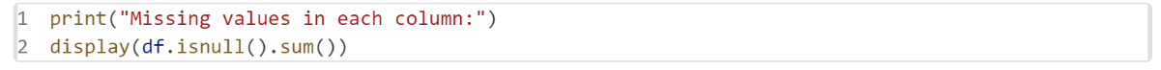
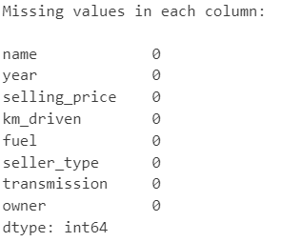
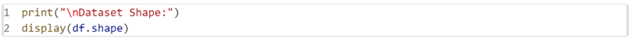


Slide 5
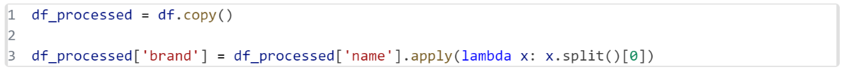
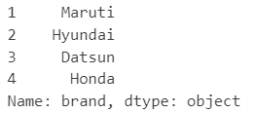
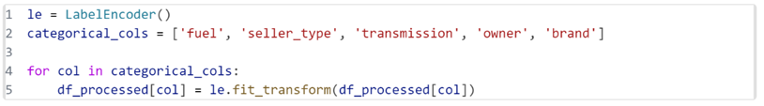
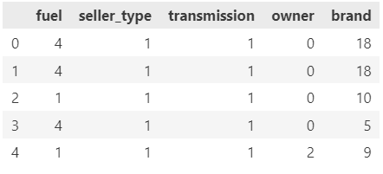

Slide 6
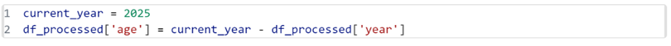
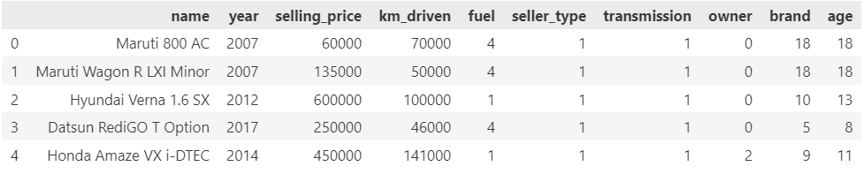
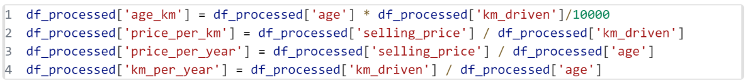
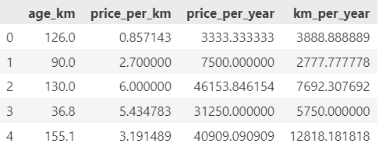

Slide 7
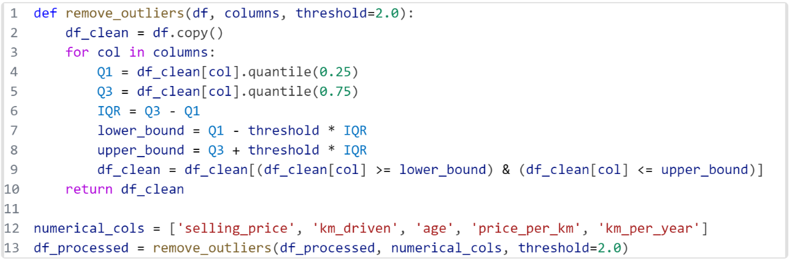
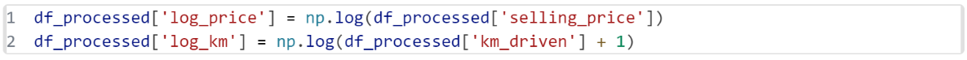
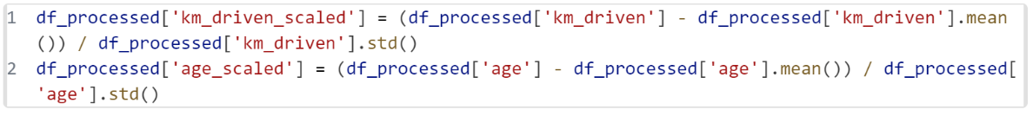

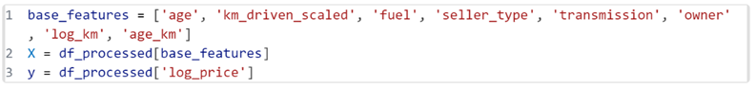

Slide 8
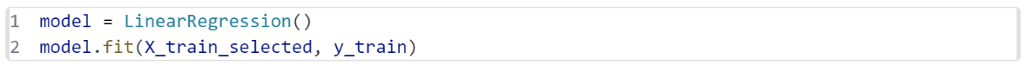

Model Selection & Evaluation

Slide 9
Key Findings
Log transformation of the target variable (car price) significantly reduced skewness and improved the model’s performance.
Feature engineering such as extracting the car’s age from the manufacturing year contributed to a better understanding of value depreciation.
The model achieved a reasonable Root Mean Squared Error (RMSE) and a strong R² score, indicating good predictive accuracy.
Fuel type, transmission, car age, and mileage were among the most influential factors in determining used car prices.
Outlier detection and removal improved the robustness and generalization of the model.
Conclusion
This regression project successfully demonstrated how linear modeling, paired with thoughtful data preprocessing and feature transformation, can be used to predict used car prices with reasonable accuracy. The use of log transformation addressed the skewness in price data, while RMSE and R² scores provided measurable performance metrics. The final model can serve as a foundational tool for developing more advanced pricing systems or integrating into car selling platforms for enhanced decision-making.

